Slide 1
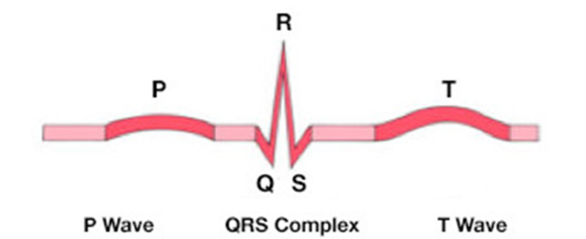
ECG Signals
o Cardiac action potentials
o Body-surface potentials
o Lead placement
o Waveforms
o QRS complex
o Normal and abnormal rhythms
18.1.2 ECG signals
Unit C 18.1 Maintaining cardiovascular and monitoring equipment
Module 279 19 C Medical Instrumentation II
©
dr. Chris R. Mol, BME, NORTEC, 2017

Slide 2
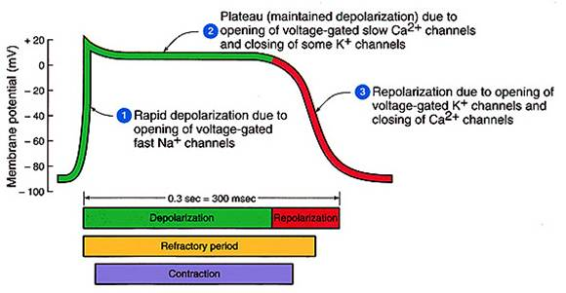
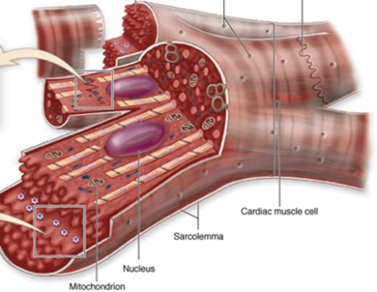
Cardiac action potentials
During a cardiac action potential the membrane potential (the difference of potential between the interior and the exterior) of a cardiac cell rises and falls.
the heart contains about 300 billion muscle cells
©
ECG Signals
dr. Chris R. Mol, BME, NORTEC, 2017

Slide 3
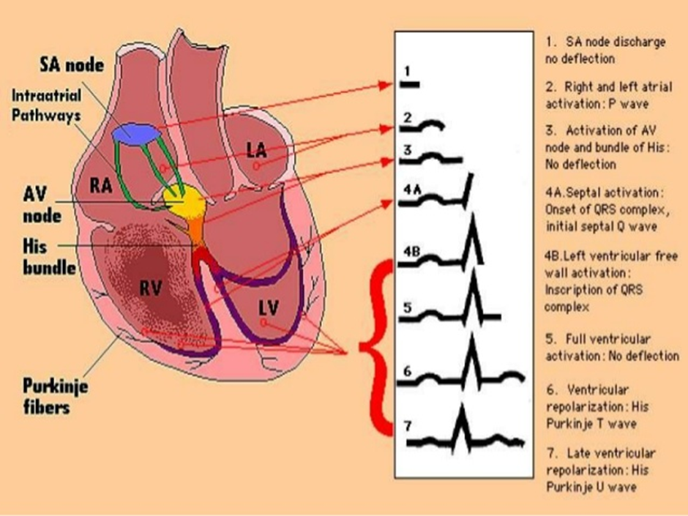
Electrical pathways in the heart
©
ECG Signals
dr. Chris R. Mol, BME, NORTEC, 2015

Slide 4
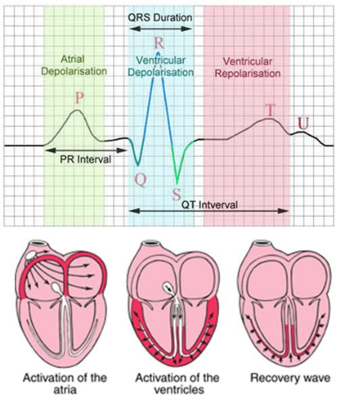
Body-surface potentials: ECG
Electrocardiography (ECG) is the process of recording the electrical activity of the heart over a period of time using electrodes placed on a patient's body. These electrodes detect the tiny electrical changes on the skin that arise from the heart muscle cells depolarizing during each heartbeat.
During each heartbeat, a healthy heart will have an orderly progression of depolarization that:
starts with pacemaker cells in the sino-atrial (SA) node, with a rhythm influenced by the central nervous system (brain),
spreads out through the atrium,
passes with a delay through the atrio-ventricular (AV) node,
spreads throughout the ventricles via specialized ‘electrical path ways’.
Note that the cardiac muscle cells also pass on the electrical signals to each other.
This orderly pattern of depolarization causes the specific ECG tracing.
©
ECG Signals
dr. Chris R. Mol, BME, NORTEC, 2017

Slide 5
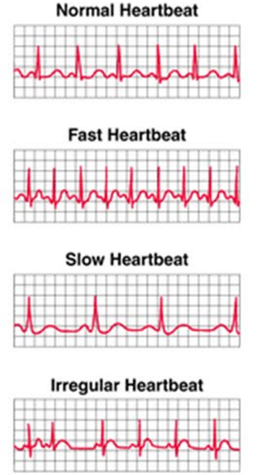
Normal and abnormal rhythms
An ECG can be used to:
measure the rate of heartbeats,
measure the rhythm (regular, irregular) of the heart beats,
measure the size and position of the heart chambers,
detect the presence of any damage to the heart's muscle cells or conduction system,
measure the effects of cardiac drugs,
measure the function of implanted pacemakers.
ECG during Ventricular Fibrillation
©
ECG Signals
dr. Chris R. Mol, BME, NORTEC, 2017

Slide 6
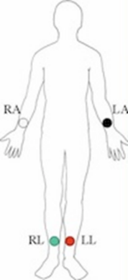
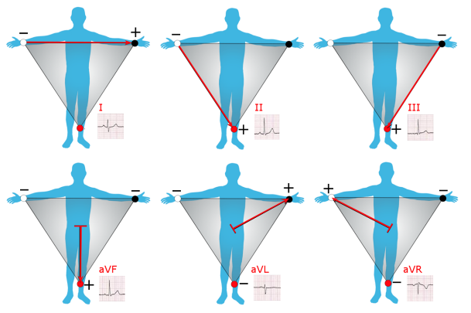
Lead Placement: 3 electrodes, 6 leads
The 3-lead ECG has been in use for over 100 years. Currently, it is mainly used on transport monitors (e.g. in ambulances). The reason for this is that configurations with more leads provide more information.
Recordings are made between two electrodes: Lead I, II, III
or
between one electrode and the average of the other two:
Lead aVR, aVL, aVF
ECG with 3 electrodes
on 3 limbs;
RL serves as ground
©
ECG Signals
dr. Chris R. Mol, BME, NORTEC, 2017

Slide 7
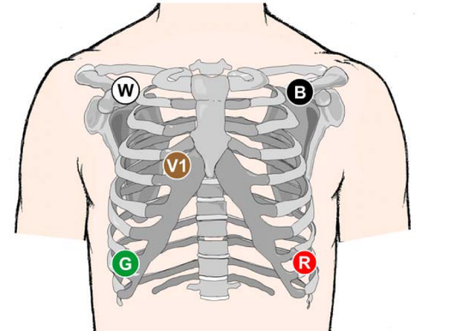
Lead Placement: 5 electrodes
The 5-lead ECG is often preferred in an
ICU (Intensive Care Unit).
It gives more information than the 3 Lead ECG.
position of electrodes in 5 Lead ECG system
©
ECG Signals
dr. Chris R. Mol, BME, NORTEC, 2017

Slide 8
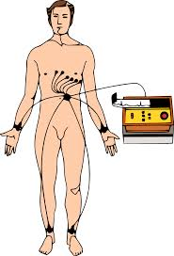
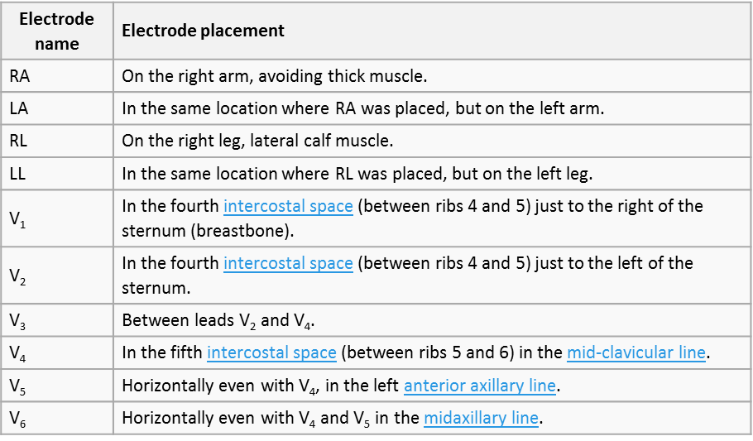
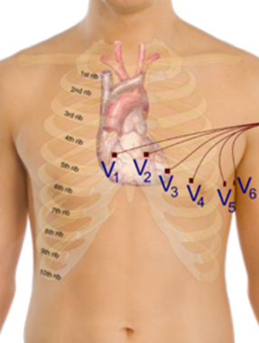
Lead Placement: 10 electrodes for standard 12 lead ECG
ECG with 10 electrodes
for best detail
From the 10 electrodes, 12 leads are recorded, each lead being a combination of two or three electrodes
©
ECG Signals
dr. Chris R. Mol, BME, NORTEC, 2017

Slide 9
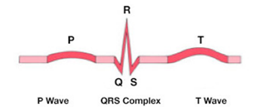
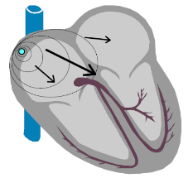
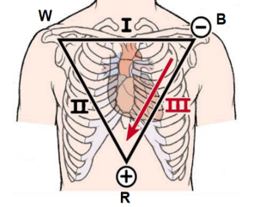
Wave forms
A depolarizing wave moving through the myocardium can be thought of as a vector. A vector is a force moving in a direction symbolized by an arrow. The larger the force, the larger the arrow.
For example, the impulse initiated by the SA node moves towards the AV node and the left atrium. On average, the depolarizing wave travels down and to the left side of the body. Atrial depolarization then has a vector that points down and towards the left.
A depolarizing electrical wave that is directed towards a positive lead produces an upright waveform on an ECG. Conversely, an inverted waveform results when a depolarizing wave moves away from a positive lead.
As an example: in lead I,II and III, the normal P-wave is always positive:
in lead I (B = positive) because the wave goes to the left side of the body
in Lead II and III (R = positive) because the wave goes to the down side of the body.
©
ECG Signals
dr. Chris R. Mol, BME, NORTEC, 2017

Slide 10
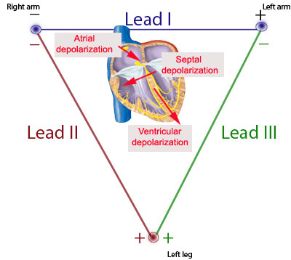
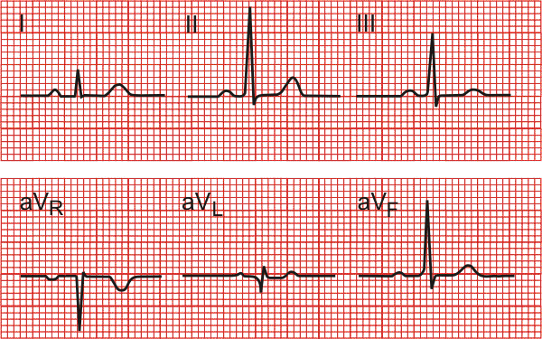
Wave forms
The heart vector changes direction in the different phases of ventricular depolarization.
This is the reason that the QRS complex changes from positive to negative, depending on the Leads from which the ECG is taken.
The following slides will give examples of common abnormalities in the ECG and their interpretation.
It shows you what sort of things the Medical Doctors are interested in, in an ECG.
©
ECG Signals
dr. Chris R. Mol, BME, NORTEC, 2017

Slide 11
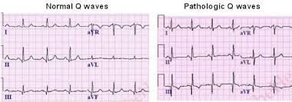
Wave forms: Abnormalities
If a part of the patient’s heart muscle is non-functional (‘old infarction’), then this will cause a change in the direction of the depolarization wave. Also the size of the heart and the orientation of the heart will have an impact on the depolarization wave.
Such variations show up in the ECG as differences in the amplitude and direction (positive, negative) compared with the normal ECG wave forms.
aVL
and
aVF
are clearly ‘not normal’
©
ECG Signals
dr. Chris R. Mol, BME, NORTEC, 2017

Slide 12
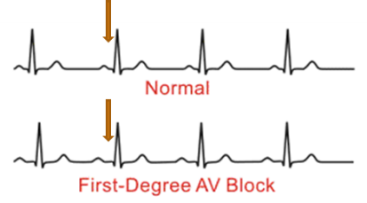
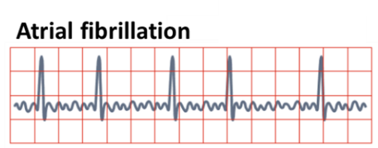
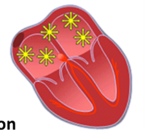
Wave forms: abnormalities in the conduction system
If a patient has a disturbance in the conduction of the electricals signals through the heart, this will show up as a change in timing within the ECG signals.
For example, an AV block (a time delay in signal conduction through the AV node) will result in a longer duration between the P wave and the QRS complex (see figure).
In Atrial Fibrillation (un-synchronized contraction of the atrial myocardium) the ECG will show up without a P-wave.
©
ECG Signals
dr. Chris R. Mol, BME, NORTEC, 2017

Slide 13
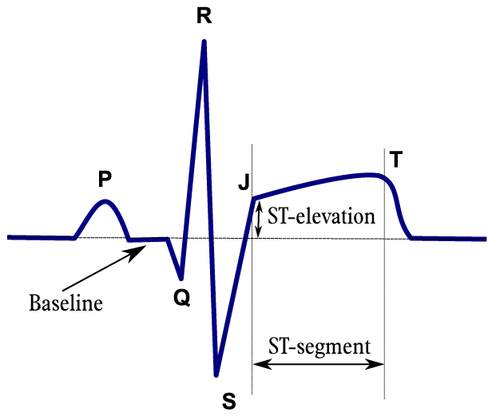
Wave forms: abnormalities through heart muscle infarction
ST elevation is a positive (non-zero) value of the ECG between the QRS wave and the T-wave. ST depression is a negative value at this time.
Both phenomena usually point at a (recent) infarction from some of the heart muscle, related to the closure/blockage of a coronary artery.
From an analysis of the ECG wave forms in the different leads it can be derived which coronary artery is blocked. This is useful information to guide further therapy (drugs, bypass surgery, or angioplasty).
©
ECG Signals
dr. Chris R. Mol, BME, NORTEC, 2017

Slide 14
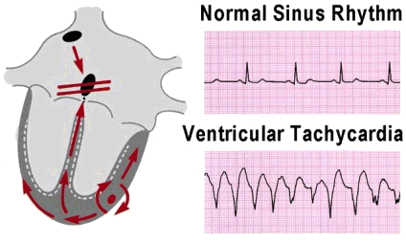
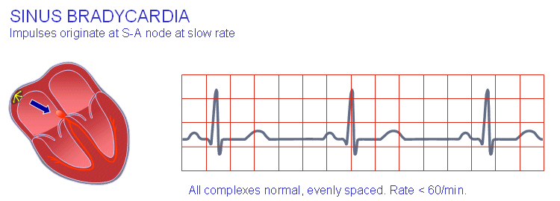
Heart Rhythm abnormalities
Tachycardia (‘tachy’ = fast, a fast heart rhythm) is defined as a heart rhythm of over 100 beats per minute for adults A tachycardia can simply be a high frequency heart beat with no other variations in the ECG.
However, tachycardia can also be associated with more serious phenomena. For example, tachycardia can be generated by abnormal ventricular heart muscle, creating its own electrical signal and triggering ventricular contractions unsynchronized with the atrium. It often runs between 120 and 260 beats/minute. This is called Ventricular Tachycardia (see figure).
Bradycardia (‘brady’ = slow, a slow heart rhythm) is the opposite phenomenon: a heart rhythm in rest of lower than 60 beats/minute. In young people this can indicate a very well trained heart. In older people it may be a sign of disease.
©
ECG Signals
dr. Chris R. Mol, BME, NORTEC, 2017

Slide 15
END
The creation of this presentation was supported by a grant from THET:
see https://www.thet.org/

